Slide 1

FEM-Design API

Slide 2
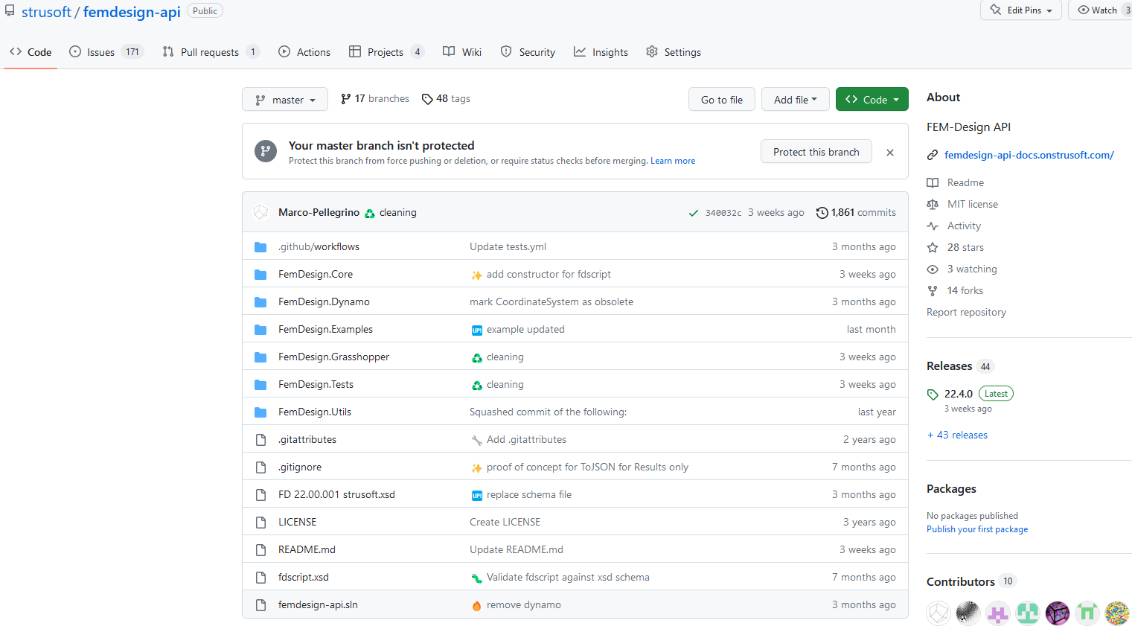

Open Source

Slide 3

Dotnet application
Notes:
Everything works thanks to the dotnet application written C#

Slide 4

Interfaces

Slide 5
Rhinoceros interface

Slide 6
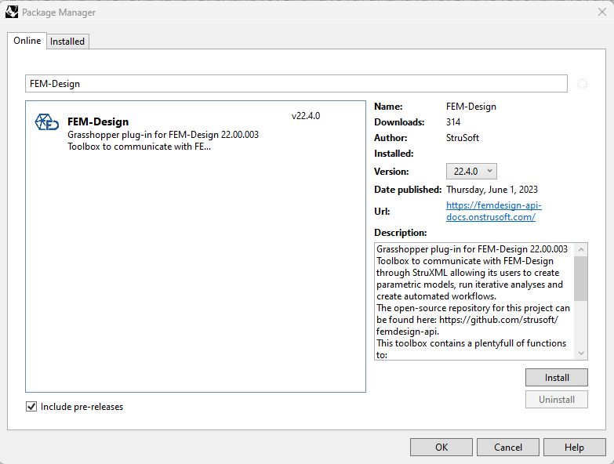

Slide 7
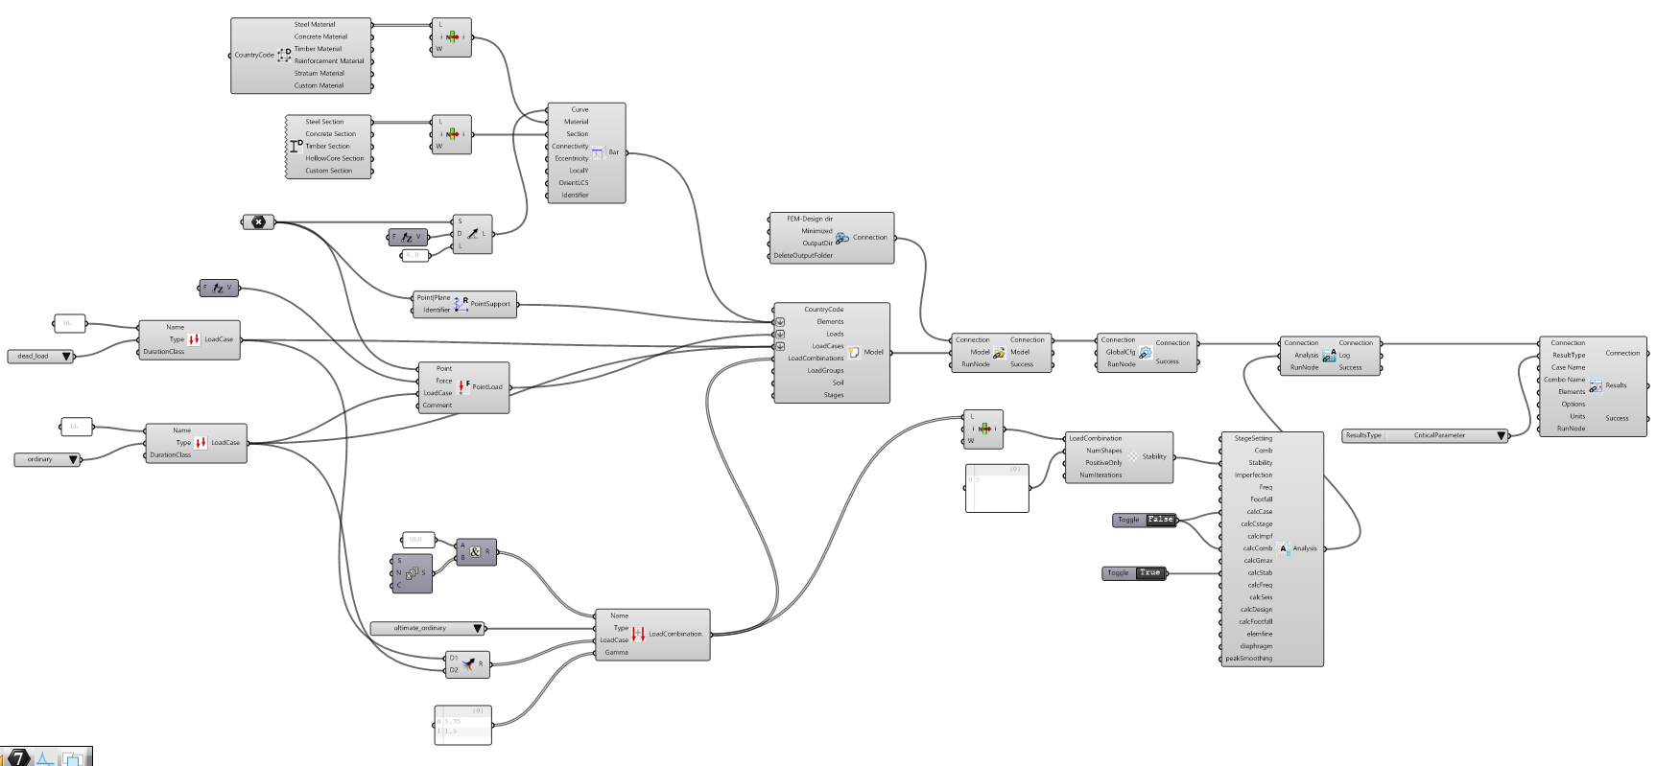
Visual programming

Slide 8
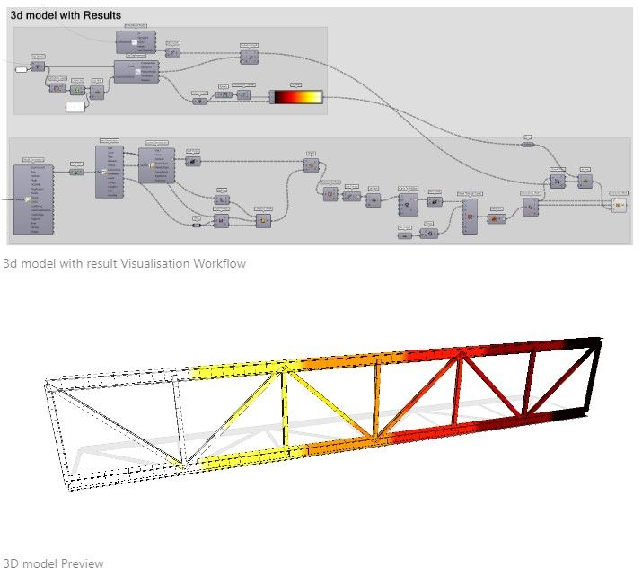
Static Analyses
Load Cases
Load Combinations

Slide 9
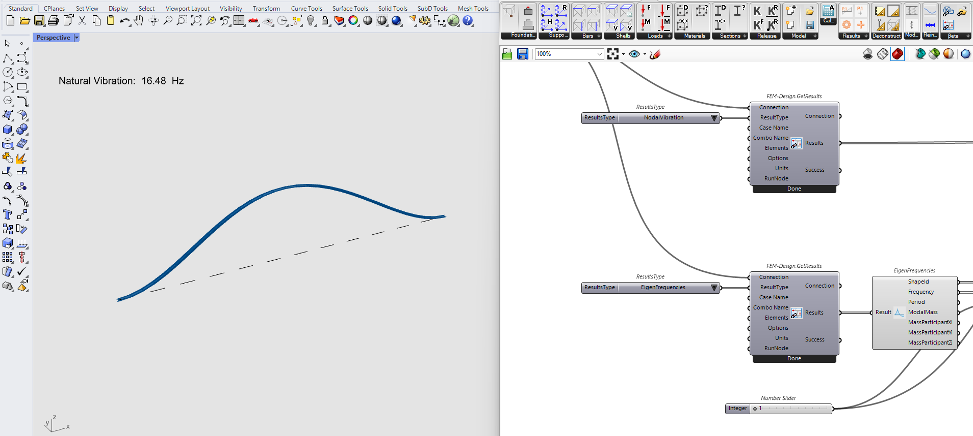
Run eigen frequencies analysis

Slide 10
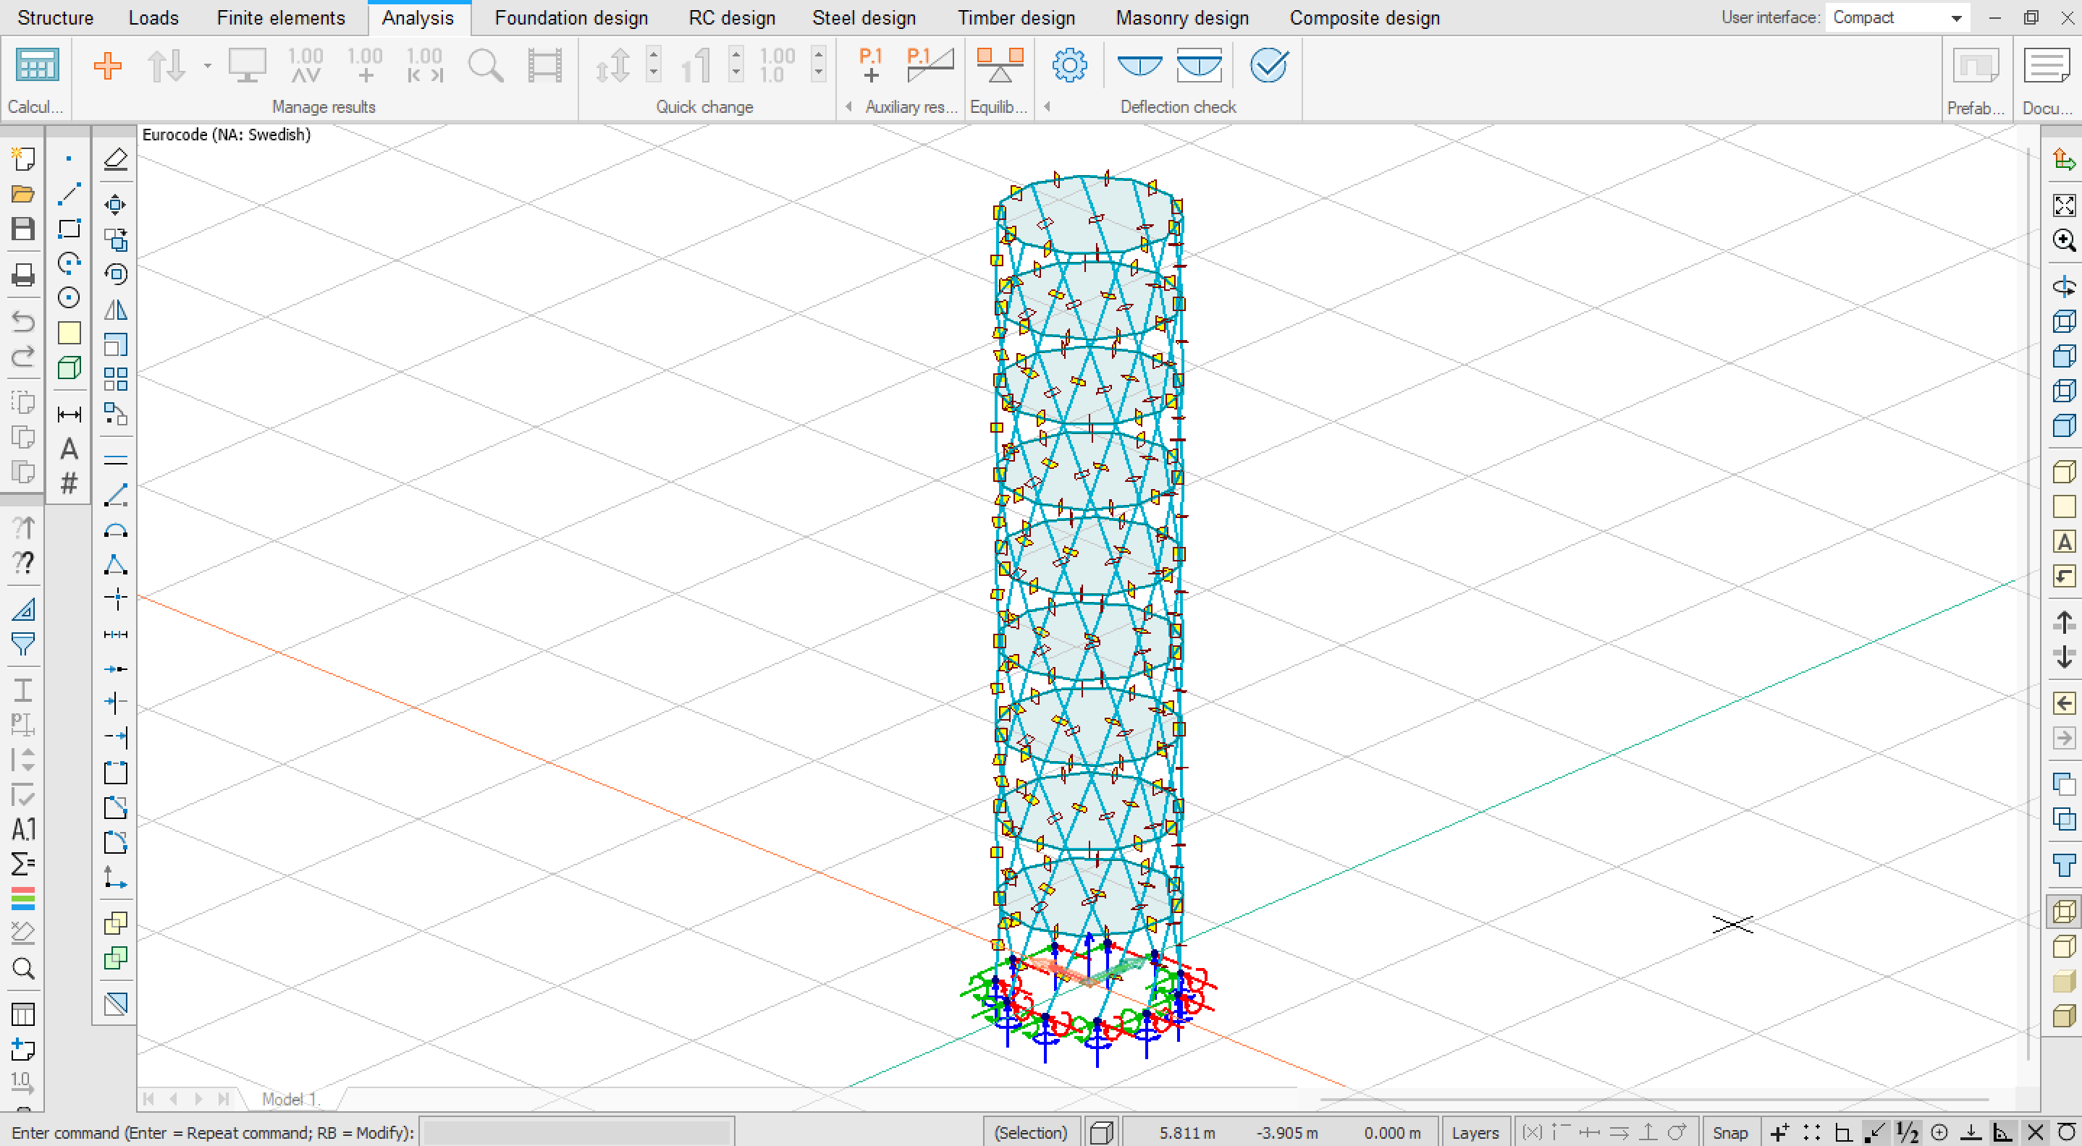
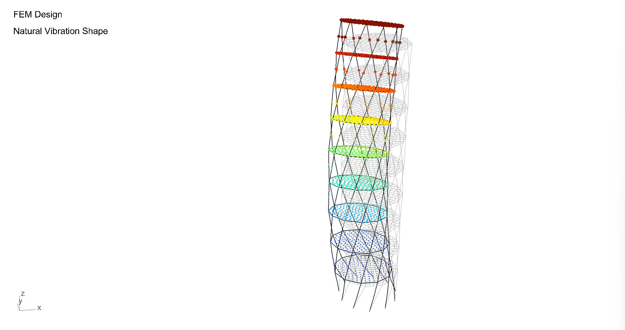
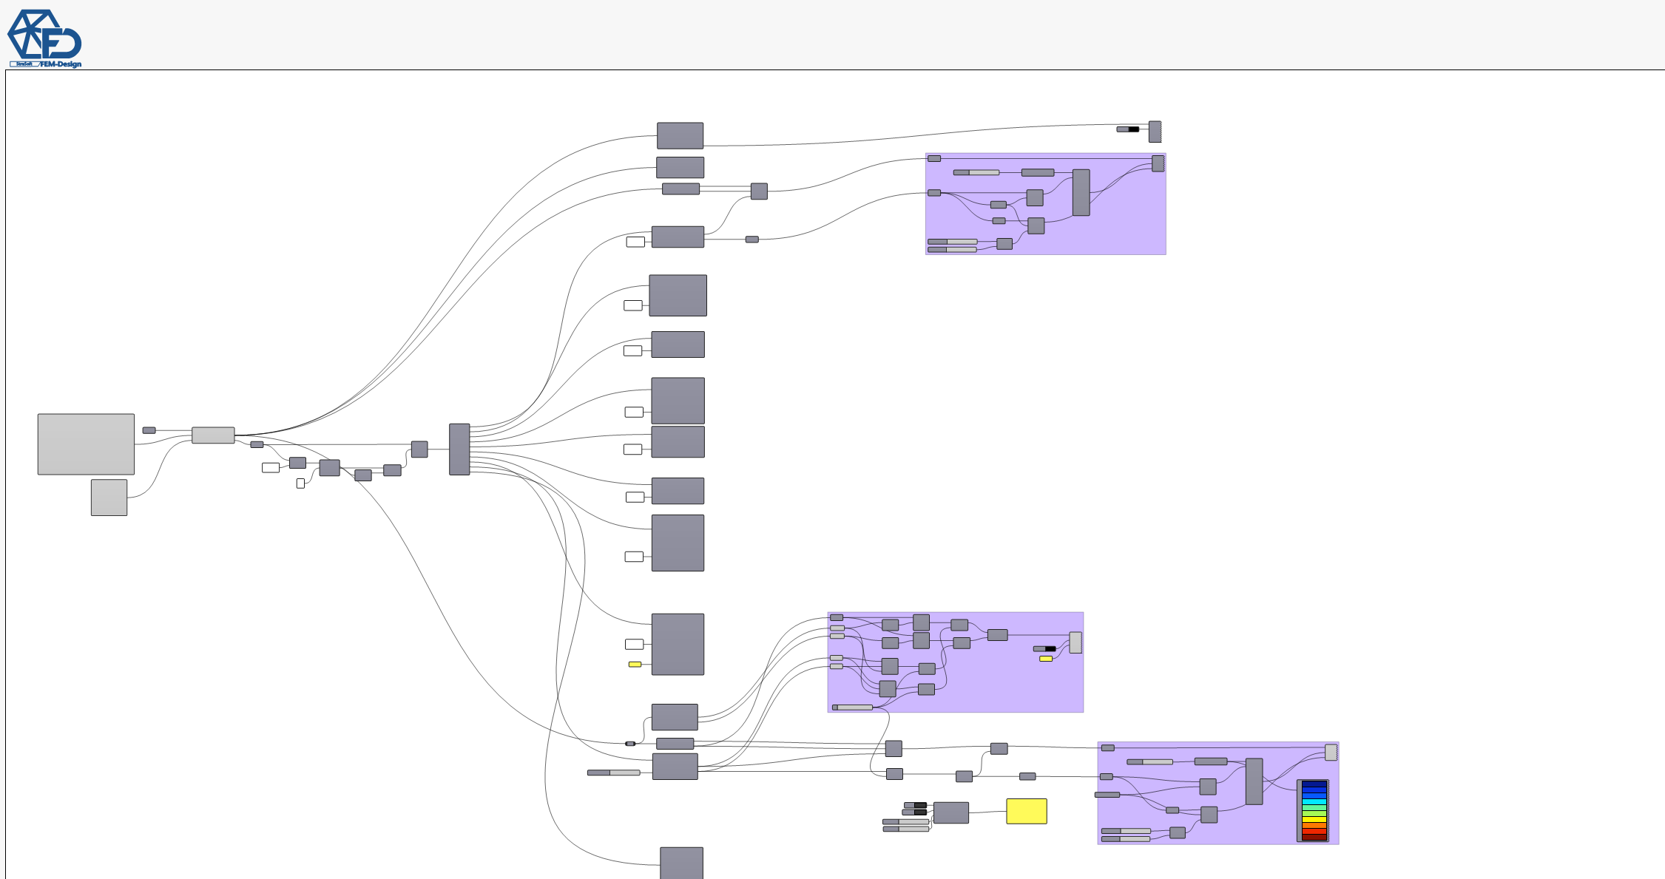
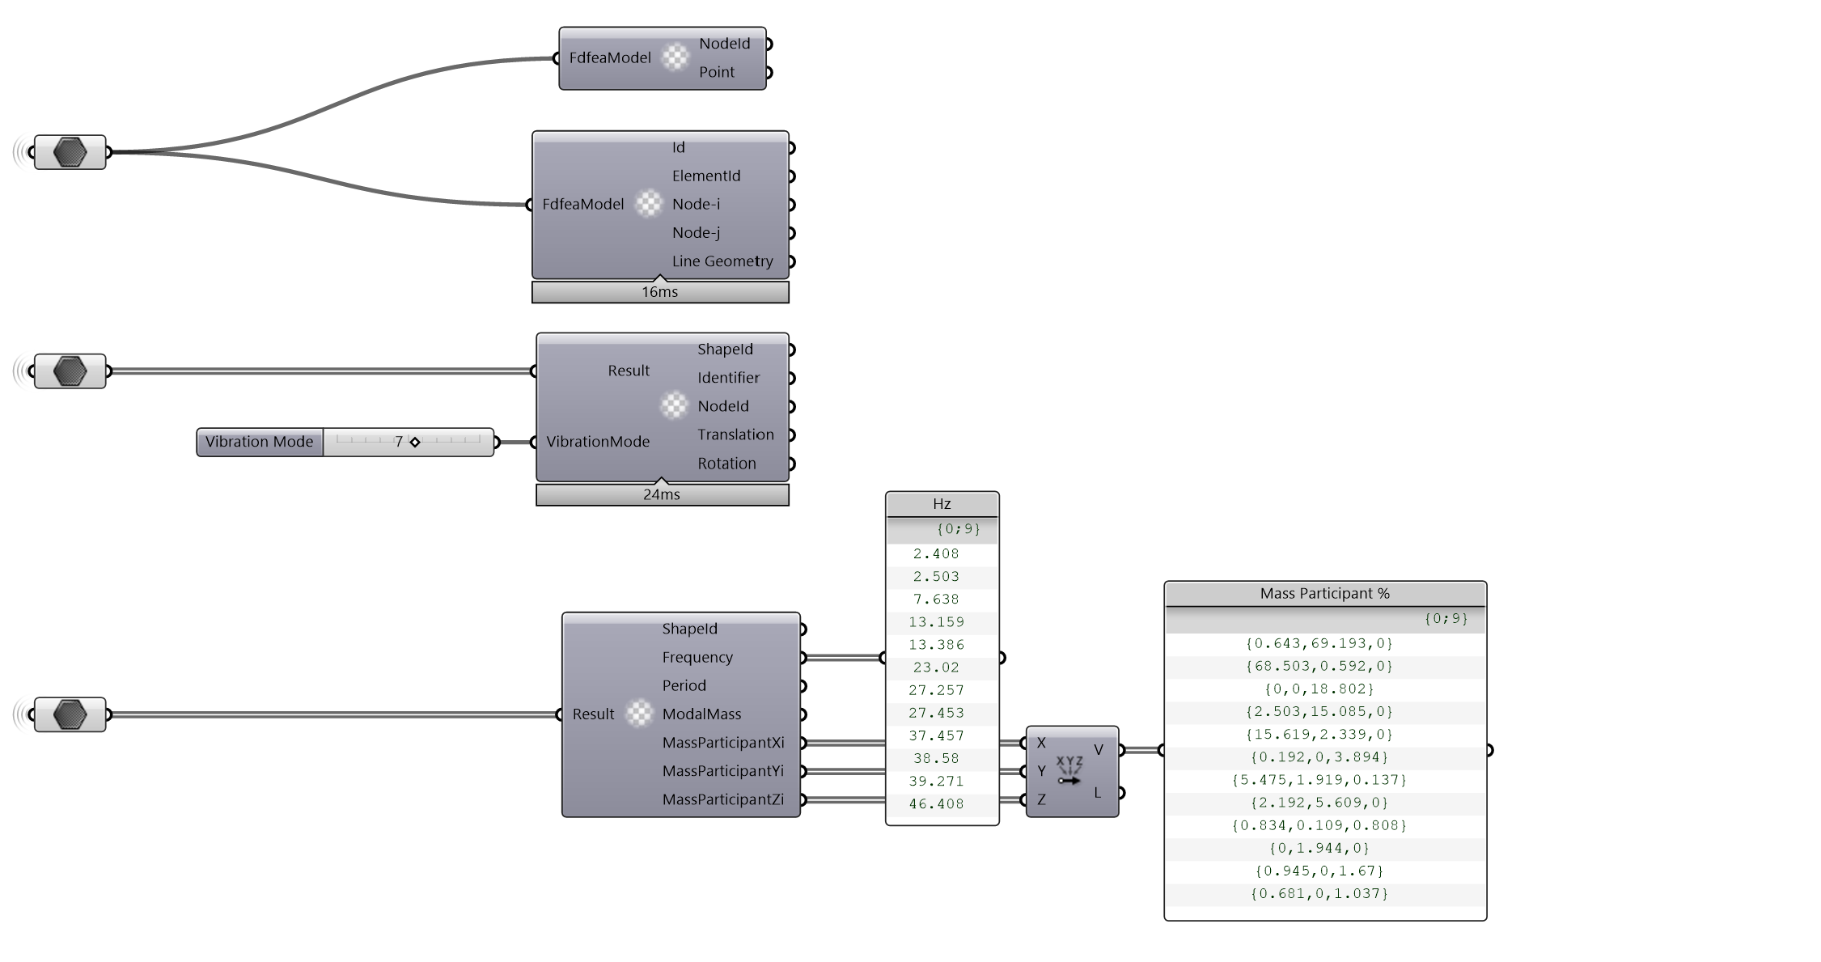

Slide 11
Run buckling analysis

Slide 12
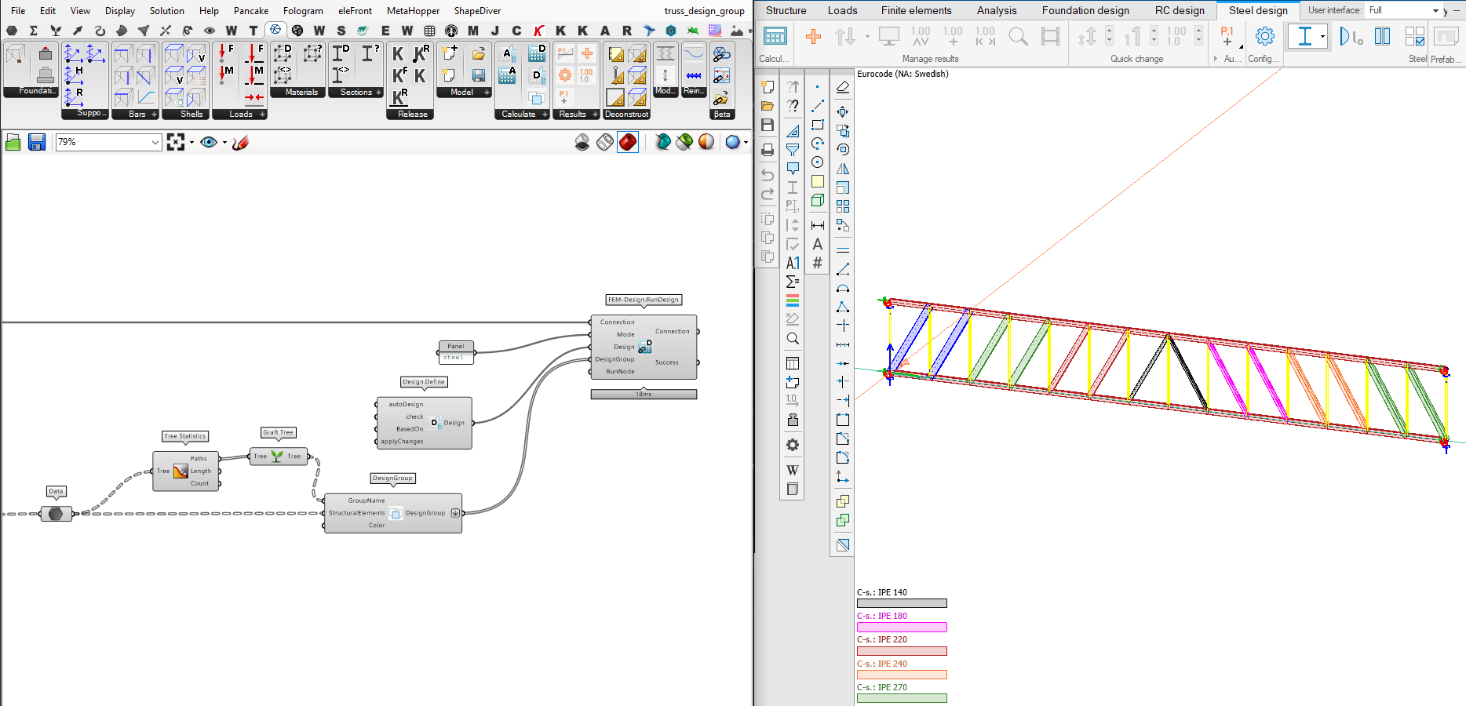
Run design with design groups

Slide 13
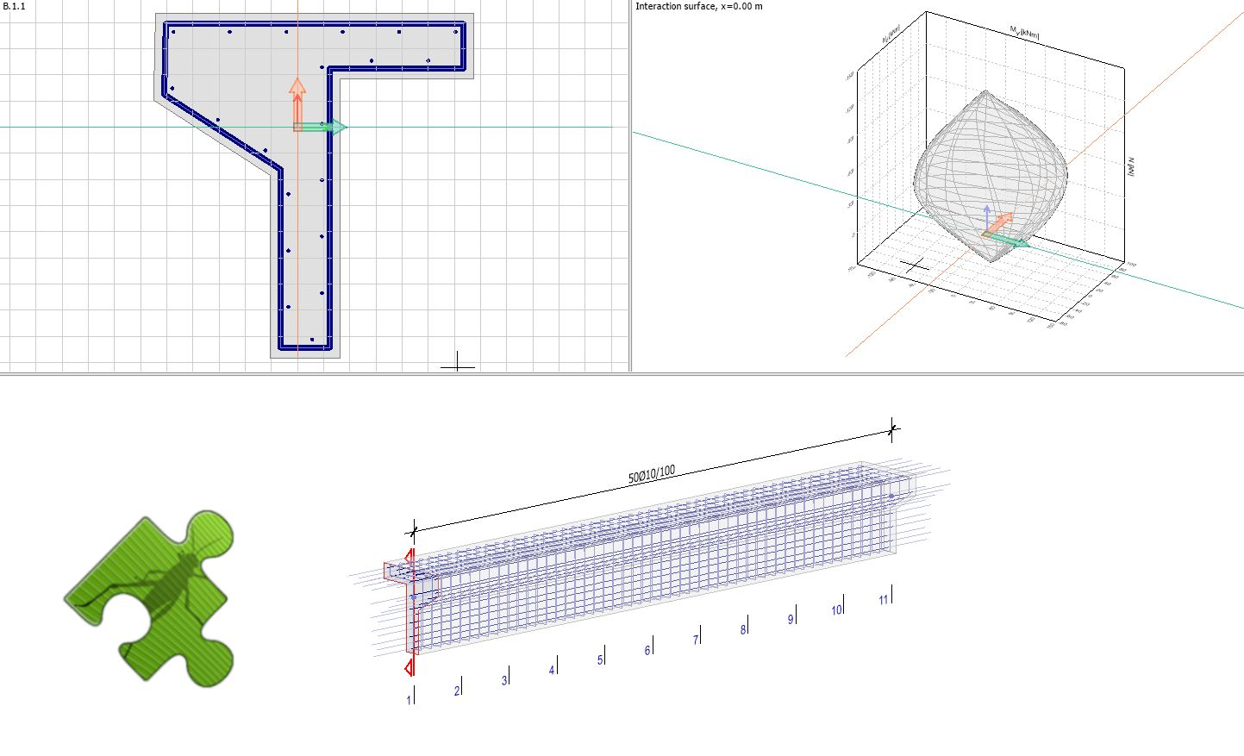
Run interaction surface for concrete

Slide 14
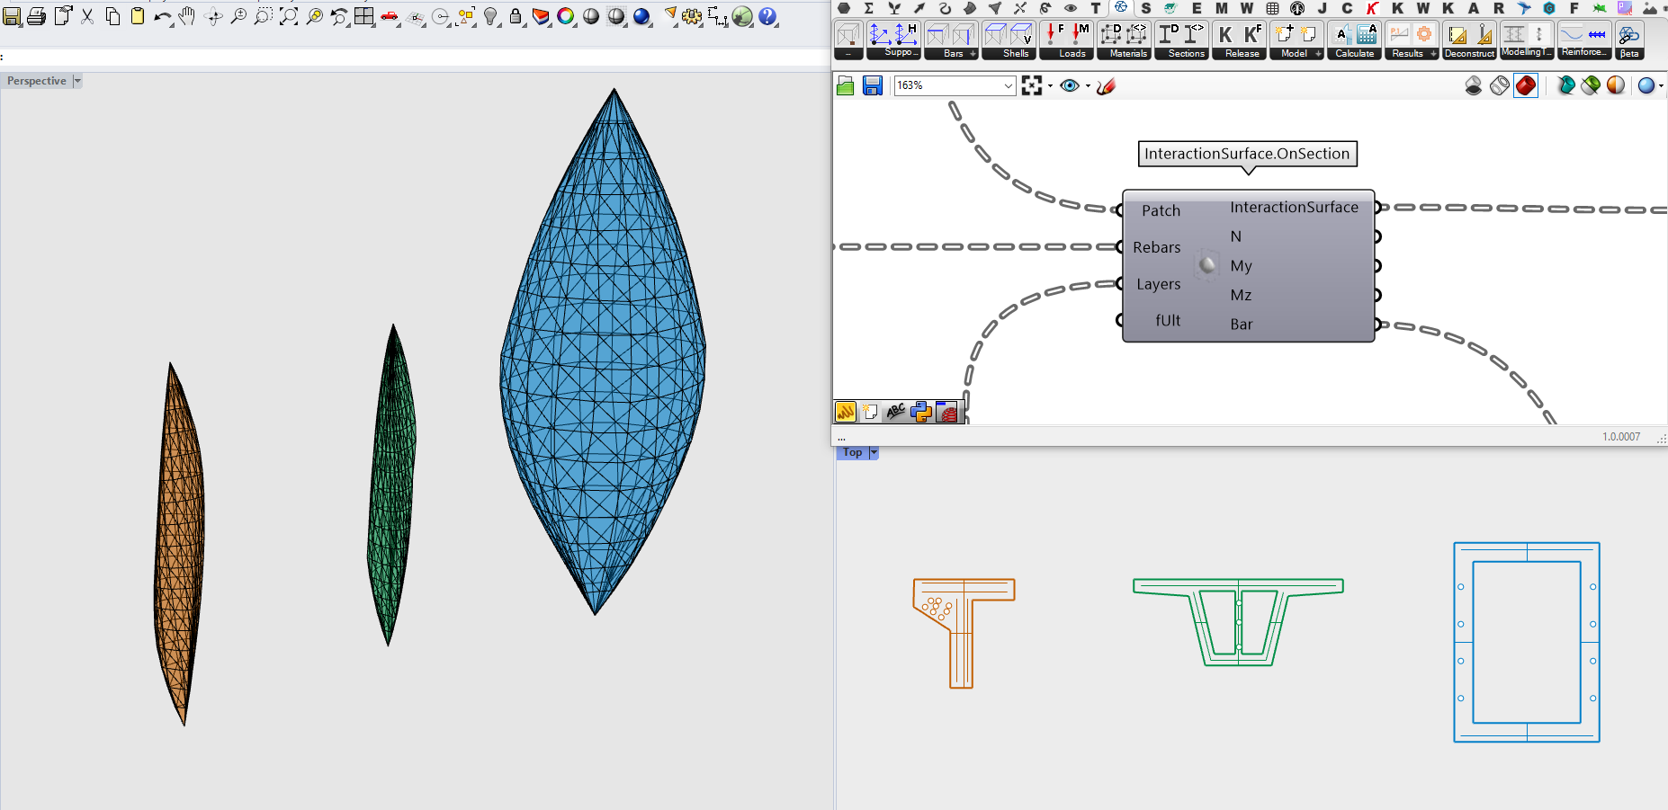
Run interaction surface for concrete

Slide 15
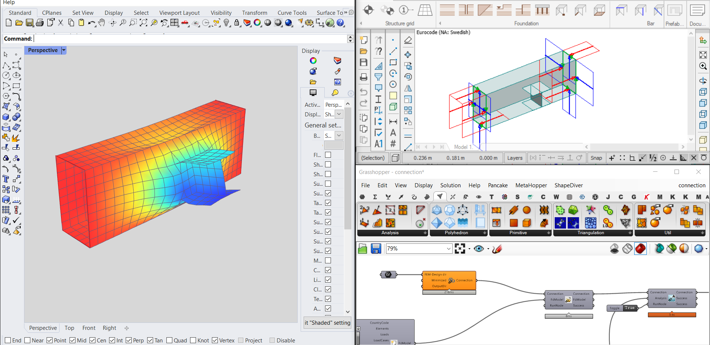
Parametric connection design?

Slide 16
Custom optimisation

Slide 17
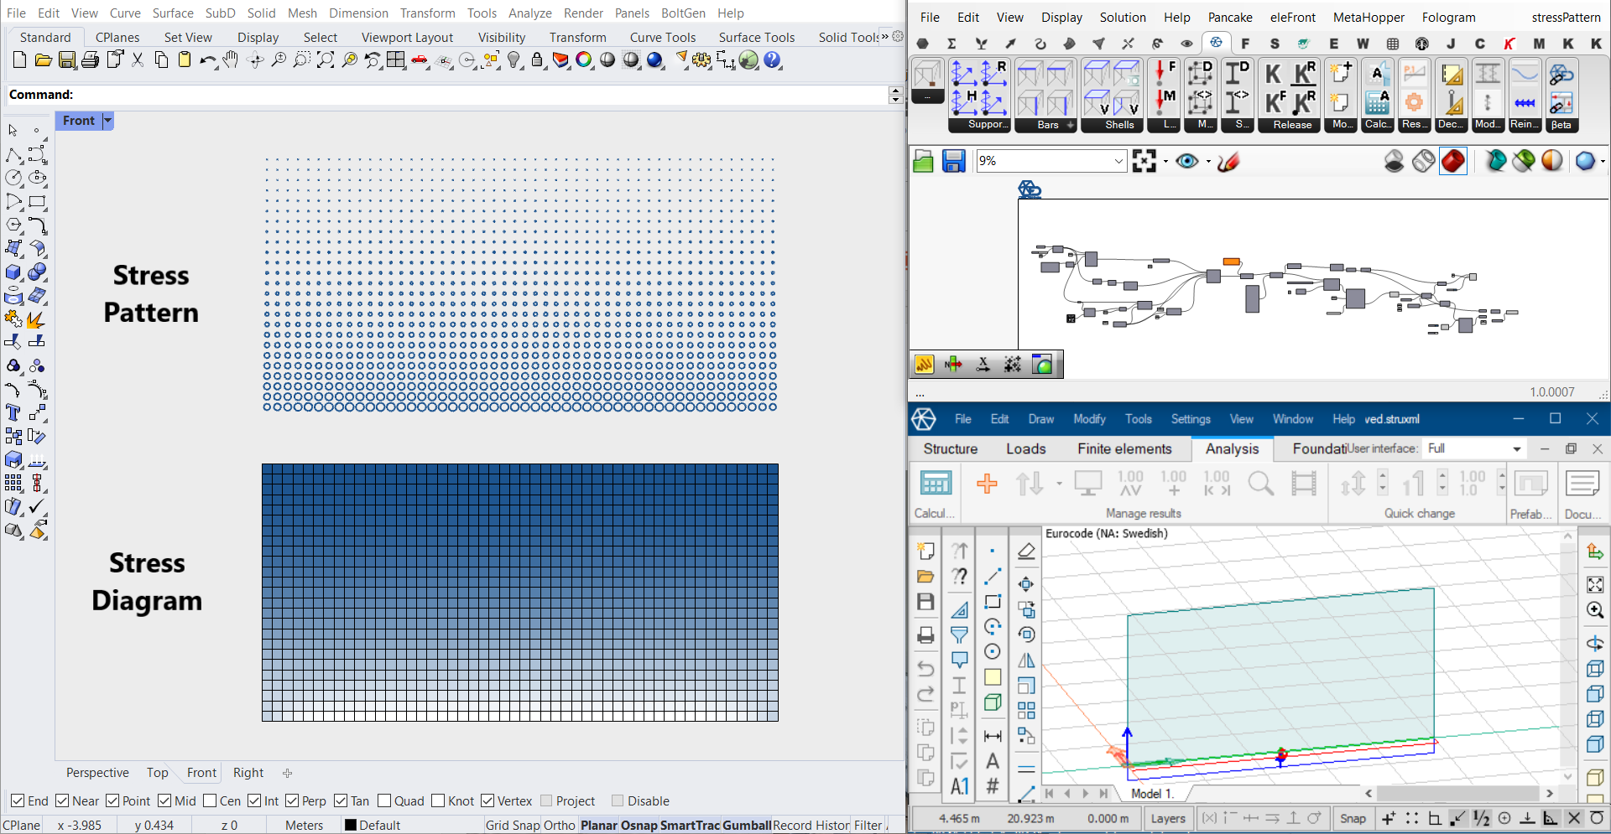
Design by data

Slide 18
Complex geometry generation

Slide 19
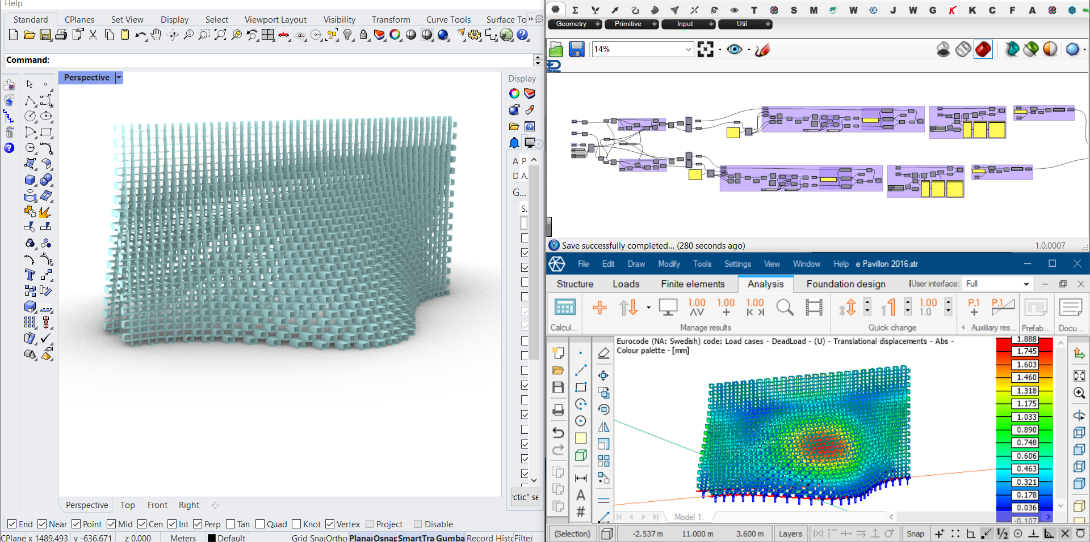
Complex geometry generation

Slide 20
Complex geometry generation

Slide 21
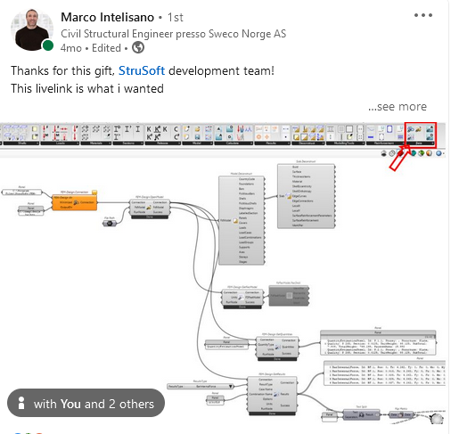
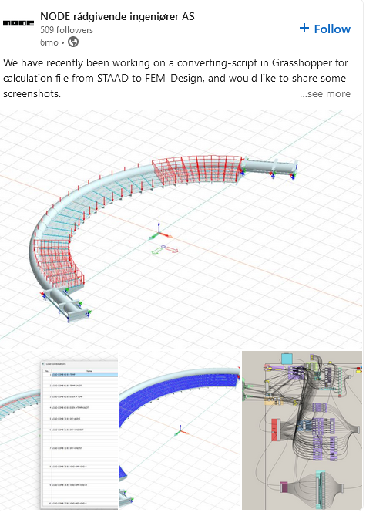
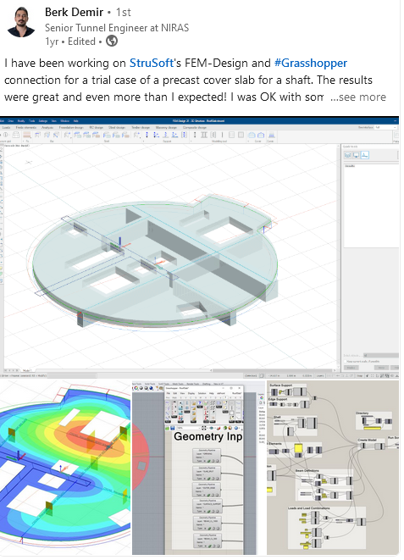
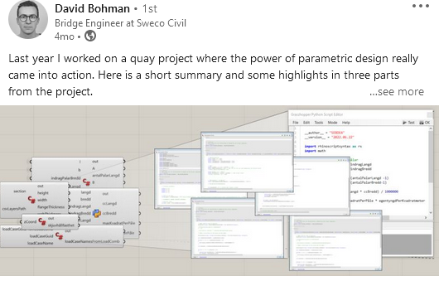

Slide 22
LIVE DEMO

